Slide 1

Keyloggers: The Hidden Threat
A keylogger is a small software or hardware device that secretly records every keystroke made on a computer, often without the user's knowledge or consent. These tools can be used for both legitimate and malicious purposes.
Dushyanth S
au820421104024
Anjalai Ammal Mahalingam Engineering College
Kovilvenni-3

Slide 2
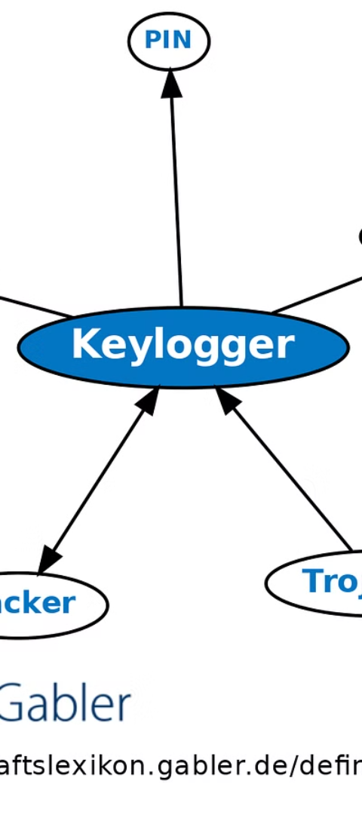
How Keyloggers Work
1
Monitoring
Keyloggers silently record every key pressed, including passwords, credit card numbers, and other sensitive information.
2
Storing
The recorded data is stored locally or transmitted to a remote server, allowing the attacker to access the stolen information.
3
Retrieving
Keyloggers can be used to remotely access the stored data, compromising the victim's security and privacy.

Slide 3
Types of Keyloggers
Software Keyloggers
Hardware Keyloggers
Wireless Keyloggers
These are programs that run in the background, monitoring and recording keystrokes.
These are physical devices that are installed between the keyboard and the computer, capturing all input.
These transmit the recorded data wirelessly, making them harder to detect.

Slide 4

Legitimate Uses of Keyloggers
1
Parental Monitoring
2
Employee Monitoring
3
Diagnostics and Troubleshooting
Keyloggers can help parents monitor their children's online activities and ensure their safety.
Employers may use keyloggers to track employee productivity and ensure appropriate use of company devices.
Keyloggers can be used to identify and resolve technical issues on a computer.

Slide 5
Risks and Dangers of Keyloggers
Identity Theft
Privacy Violation
Malicious Exploitation
Keyloggers can capture sensitive information like login credentials and financial details, leading to identity theft and fraud.
Keyloggers can invade an individual's privacy by recording personal communications and activities without their knowledge or consent.
Keyloggers can be used by cybercriminals to gain access to systems, steal data, and cause widespread damage.

Slide 6




Protecting Against Keyloggers
Antivirus
Firewall
Encryption
Physical Security
Use reliable antivirus software to detect and remove any installed keyloggers.
Maintain a robust firewall to block unauthorized access and prevent remote keylogger communication.
Encrypt sensitive data and communications to prevent keyloggers from accessing the information.
Regularly inspect devices for any physical tampering or installation of hardware keyloggers.

Slide 7




Detecting Keyloggers
System Monitoring
Hardware Inspection
Anti-Keylogger Tools
Monitor system processes and network activity for any suspicious behavior that could indicate the presence of a keylogger.
Visually inspect the computer and its peripherals for any unfamiliar or suspicious hardware components that may be keyloggers.
Use specialized software designed to detect and remove keyloggers, providing an additional layer of protection.

Slide 8
Legal and Ethical Considerations
Legal Restrictions
The use of keyloggers is strictly regulated in many jurisdictions, with specific rules regarding consent and authorized use.
Privacy Concerns
Keyloggers can violate an individual's right to privacy and may be considered a breach of trust in personal or professional settings.
Ethical Dilemmas
The use of keyloggers raises ethical questions about the balance between security, productivity, and personal freedom.

Slide 9


